Slide 1


BETWEEN
GERMANY
AND BULGARIA:
EVIDENCE FROM A BUS SURVEY
Vesselin Mintchev
/Economic Research Institute at BAS – Sofia/
Venelin Boshnakov
/University of National and World Economy – Sofia/
CONFERENCE ON INTERNATIONAL MIGRATION
14th February 2014, ERI at BAS – Sofia, Bulgaria

Slide 2

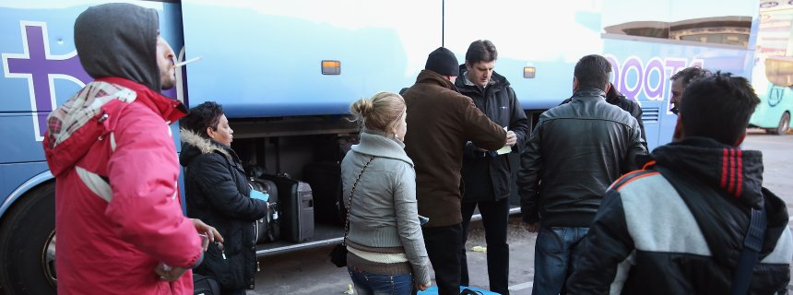
Field
Work
Project: Bulgarian Diaspora in Western Europe: Transborder Mobility, National Identity, and Development“
Project supported by: Grant No ДИД 02/21-IDEAS of the Bulgarian Science Fund
Survey conducted in the period: April – May 2013
Professional interviewer teams of ASA – located in Sofia and district center cities – starting points of bus lines BG–>GE
Face-to-Face interviews
on the territory of Inter-
national Bus Stations –
half an hour before the
departure time

Slide 3
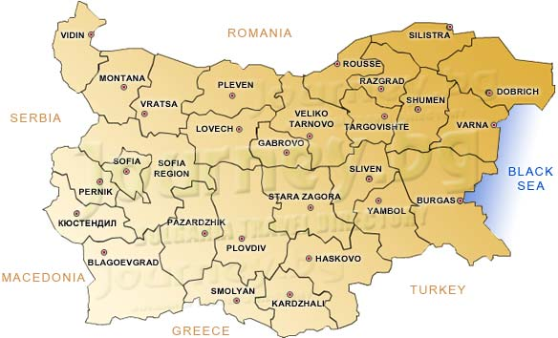
Field Work

Slide 4
Sample split
 | Frequency | Percent |  | Where did you live most of the time during the last 12 months?
Bulgaria | 666 | 82.5
Germany | 140 | 17.3
Other country | 1 | 0.1
Total | 807 | 100.0
How much time do you live in Germany?
 | Frequency | Percent
Up to 1 year | 7 | 5.9
Over 1 to 5 years | 76 | 63.9
Over 5 to 10 years | 22 | 18.5
Over 10 years | 14 | 11.8
Total | 119 | 100.0

Slide 5
Demographics
Where do you live in Germany?
Berlin | 6.5
Large city, >500 th. (Hamburg, Munich, etc.) | 71.7
Other city/town | 19.6
Small settlement / Farm | 2.2
Total | 100.0
Ethnical group | Percent
Bulgarian | 87.7
Turkish | 11.6
Roma | –
Other | 0.7
Total | 100.0

Slide 6
Demographics
Age group | Male | Female | Total
Up to 25 | 15.0 | 13.8 | 14.4
26 – 35 | 39.9 | 38.5 | 39.2
36 – 45 | 31.5 | 26.6 | 29.1
Over 45 | 13.6 | 21.1 | 17.2
Total | 100.0 | 100.0 | 100.0
Age group | Yes | No | Total
Up to 30 | 19.4 | 80.6 | 100.0
31 – 39 | 79.2 | 20.8 | 100.0
40+ | 44.4 | 55.6 | 100.0

Slide 7
Main reasons to settle in Germany
 | Responses |  | Percent of Cases
 | N | Percent
To have a higher living standard | 51 | 20.2 | 37.5
To get a higher pay | 94 | 37.3 | 69.1
Better professional realization | 24 | 9.5 | 17.6
To provide support to my family/relatives | 38 | 15.1 | 27.9
To provide the desired education to me/my children | 13 | 5.2 | 9.6
Marriage/Partnership | 12 | 4.8 | 8.8
Family unification (to join family, relatives) | 1 | 0.4 | 0.7
To accompany my spouse abroad | 9 | 3.6 | 6.6
To obtain foreign citizenship | 2 | 0.8 | 1.5
I just wanted to live in Germany | 8 | 3.2 | 5.9
Total: | 252 | 100.0

Slide 8
Occupation in Germany / in BG before moving to GE
 | Germany | Bulgaria
Agriculture | 1.4 | 0.7
Construction | 22.9 | 20.7
Personal assistant | 9.3 | –
Driver | 3.6 | 2.9
Low-qualified personnel | 0.7 | 2.1
Housekeeping | 3.6 | 0.7
Medium-qualified technical personnel | 10.0 | 10.7
Medium-qualified personnel in trade/tourism | 12.9 | 14.3
Medium-qualified personnel in other sectors | 5.7 | 7.1
High-qualified personnel | 10.0 | 20.7
Without particular job | – | 1.4
Total | 80.0 | 81.4
Not responded | 20.0 | 18.6

Slide 9
Qualification (mis)match
Job qualification in Bulgaria | Job qualification in Germany
 | Low | Medium | High | Total
Low | 70.0 | 20.0 | 10.0 | 100.0
Medium | 8.2 | 90.2 | 1.6 | 100.0
High | 7.1 | 53.6 | 39.3 | 100.0
Total: | 14.1 | 72.7 | 13.1 | 100.0

Slide 10
Type of labour contracting
If working– What kind of contract do you have in Germany?
 | Percent
Permanent labour contract | 35.0
Term labour contract | 37.1
No contract (informal) | 5.7
Self-employed /family unit/ | 5.7
Other | 1.4
Total responded | 85.0
Not responded | 15.0

Slide 11
Earnings in Germany
Usually, what share of your earnings do you send to your family/relatives in BG? | %
I do not send money | 12.9
Not more than 1/4 | 20.0
About 1/3 | 27.1
About 1/2 | 27.1
About 2/3 | 3.6
About 3/4 | 0.7
Almost everything | 0.7
Total responded | 92.1
Not responded | 17.9
Approximate monthly income | %
Up to 1000 EUR | 25.5
Over 1000 to 1500 EUR | 43.6
Over 1500 to 2000 EUR | 23.6
Over 2000 EUR | 7.3
 | 100.0

Slide 12
Attitudes of local people to Bulgarians in Germany
How do you evaluate the attitude of the local people in Germany to Bulgarians? | Frequency | Percent
Very good | 37 | 26.4
Relatively good /positive | 82 | 58.6
Bad /negative | 9 | 6.4
Cannot judge | 9 | 6.4
Total responded | 137 | 97.9
Not responded | 3 | 2.1

Slide 13
2. Bulgarian residents leaving to Germany
Age | Male | Female | Total
Up to 25 | 16.8 | 13.8 | 15.4
26 – 35 | 41.3 | 38.8 | 40.1
36 – 45 | 29.2 | 25.8 | 27.6
Over 45 | 12.7 | 21.5 | 17.0
 | 100.0 | 100.0 | 100.0
To which ethnical group do you put yourself?
 | Frequency | Percent
Bulgarian | 591 | 88.7
Turkish | 27 | 4.1
Roma | 43 | 6.5
Other | 2 | 0.3
Total resp. | 663 | 99.5
Not resp. | 3 | 0.5
Settlement | Percent
Sofia | 30.5
District center city | 39.1
Other city / Town | 25.0
Village | 5.4
Total | 100.0

Slide 14
Educational level
What is your higher level of education (for which you have diploma/certificate)? | Frequency | Valid Percent
No formal degree | 7 | 1.1
Primary | 16 | 2.4
Basic | 40 | 6.0
Secondary general | 175 | 26.4
Secondary professional | 297 | 44.7
Higher (Bachelor) | 77 | 11.6
Higher (Master) | 49 | 7.4
Higher (PhD) | 3 | 0.5
Total | 664 | 100.0

Slide 15
Main reason to leave to Germany
 | N | %
Holiday, excursion travel | 43 | 6.5
I intend to work in Germany | 309 | 46.4
Personal matter: visiting relatives, family, health care | 156 | 23.4
Business matter: business trip, deals, etc. | 35 | 5.3
Search for temporary job in Germany | 109 | 16.4
Education in Germany | 5 | 0.8
I leave BG in order to settle in GE | 4 | 0.6
I travel to a different country | 2 | 0.3
Other | 3 | 0.5
Total | 666 | 100.0

Slide 16
Migration intentions
How likely is for you in the near future: | Not likely | Little likely | Some-what likely | Very likely | Total
To work for a few months in Germany | 23.3 | 6.5 | 14.3 | 55.9 | 100.0
To study for a few months in Germany | 84.7 | 9.1 | 3.5 | 2.7 | 100.0
To work for 1+ years in Germany | 39.1 | 20.4 | 21.5 | 19.0 | 100.0
To study for 1+ tears in Germany | 85.0 | 9.3 | 3.7 | 2.0 | 100.0
To settle permanently in Germany | 62.4 | 23.5 | 9.1 | 5.0 | 100.0

Slide 17
Reasons to choose Germany
 | Responses |  | Percent of Cases
 | N | Percent
To have a higher living standard | 114 | 16.1 | 20.9
To get a higher pay | 342 | 48.4 | 62.6
Better professional realization | 52 | 7.4 | 9.5
To provide support to my family/relatives | 42 | 5.9 | 7.7
To provide the desired education to me/my children | 10 | 1.4 | 1.8
Marriage/Partnership | 1 | 0.1 | 0.2
Family unification (to join family, relatives) | 71 | 10.1 | 13.0
To accompany my spouse abroad | 9 | 1.3 | 1.6
To obtain foreign citizenship | – | – | –
Cannot find a job in Bulgaria | 51 | 7.2 | 9.3
I JUST DO NOT WANT TO LIVE IN BULGARIA ANY MORE | 14 | 2.0 | 2.6
(Valid cases: 543) | 706 | 100.0

Slide 18
Intended occupation in Germany /
Occupation in Bulgaria before leaving
 | Germany | Bulgaria
Agriculture | 25.1 | 2.8
Construction | 21.9 | 19.5
Personal assistant | 11.5 | 0.9
Driver | 2.2 | 7.3
Low-qualified personnel | 0.7 | 3.1
Housekeeping | 4.2 | 0.9
Medium-qualified technical personnel | 6.6 | 16.5
Medium-qualified personnel in trade/tourism | 10.3 | 21.2
Medium-qualified personnel in other sectors | 1.5 | 3.8
High-qualified personnel | 3.4 | 17.9
Cannot judge (whatever job) / No particular job | 9.8 | 5.9
Not answered | 2.7 | 0.2
Total | 100.0 | 100.0

Slide 19
THANK YOU FOR YOUR ATTENTION

